Slide 1
Introduction to Programming
Lecture 8

Slide 2
Agenda
File Handling:
File reading and writing – Part 1

Slide 3
File Handling
File handling is either:
File Writing: storing data permanently in a file on the hard disk.
File Reading: reading an existing file from the hard disk.
File handling involves the following steps:-
Handling the naming of the file.
Opening the file
Writing data into the file/Reading data from the file.
Closing the file.

Slide 4
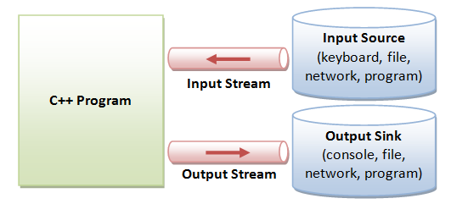
Streams in C++
The sequence of bytes given as input to the executing program and the sequence of bytes that comes as output from the executing program are called streams.
Streams are the flow of data in a sequence.

Slide 5
C++ useful streams
C++ provides a built-in library fstream to allow programs to access files.
ofstream
(output file stream)
This data type represents the output file stream and is used to create files and to write information to files.
ifstream
(input file stream)
This data type represents the input file stream and is used to read information from files.
fstream
(file stream)
This data type represents the file stream, and has the capabilities of both ofstream and ifstream which means it can create files, write information to files, and read information from files.

Slide 6
Writing to a file

Slide 7

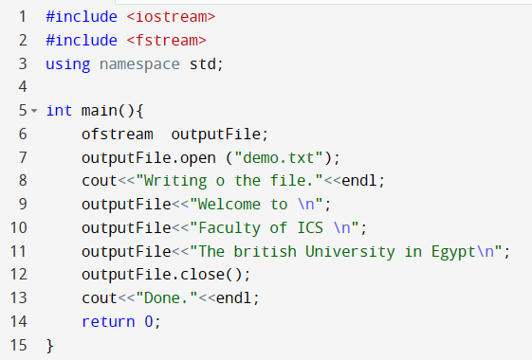




Writing to a file
include fstream
declare a variable (object) from ofstream
open a stream for writing
writing to the file
Close the stream

Slide 8
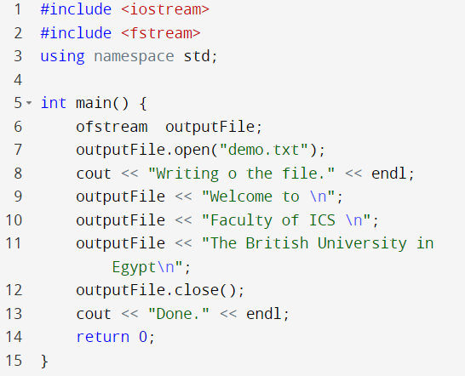
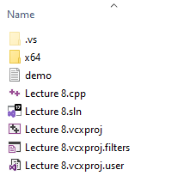
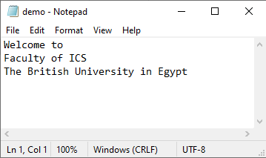




Writing to a file
cout for printing on the console
ofstream variable is for printing to the file.

Slide 9
Writing to a file
If the file does not exist, the outputFile creates an empty file of this name.
The file by default is created in the same path of the C++ code project.
To specify a different path for the file, the new path is added as follows: “c:\\data\\demo.txt”.
outputFile.open("c:\\data\\demo.txt");
Closing a file causes any unsaved data that may still be held in a buffer to be saved to its file. This frees unnecessary resources for better performance, like removing the buffered file contents that is allocated in the memory.

Slide 10
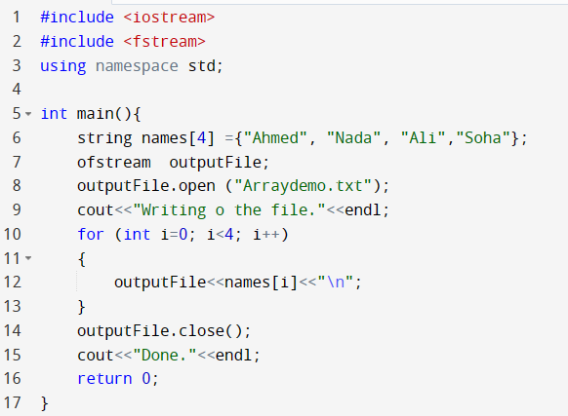
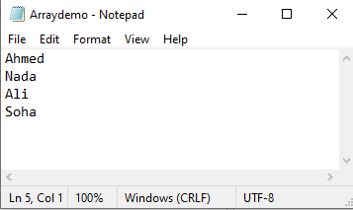
Writing to a file – example 2

Slide 11
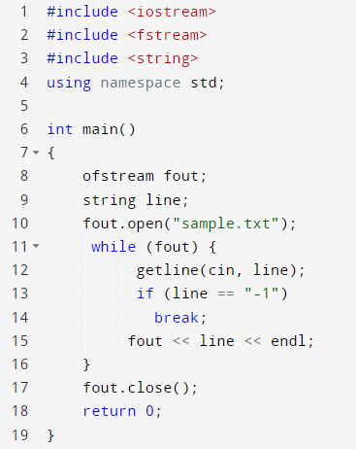
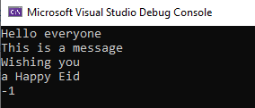
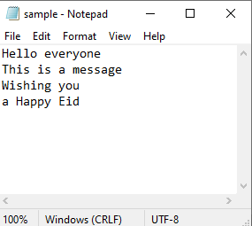

Writing to a file – example 3
Write a program that takes the string lines input by the user from the console, and stores it in a file, until the user enters value -1.
Execute a loop
if file is successfully
opened

Slide 12
Reading from a file

Slide 13
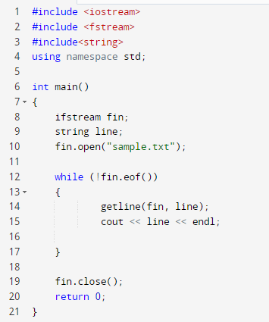
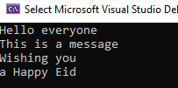

Reading from a file
Write a program that reads the lines written in example 3.
Execute a loop
While not EOF (end of file)

Slide 14
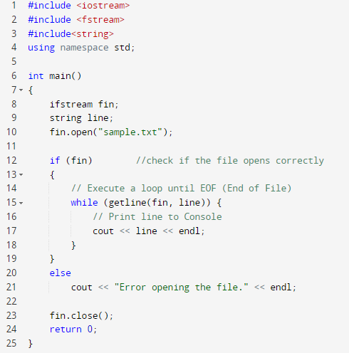




Reading from a file
Write a program that reads the lines written in example 3.

Slide 15
Modes and Default modes
mode | action | example | Default mode
ios::in | Open a file for reading only | ifstream fin; fin.open(“sample.txt”, ios::in) | fin.open(“sample.txt”) by default open mode is ios::in mode
ios::out | Open a file for writing only. If the file does not exist, it is created. If the file already exists, its contents are deleted (the file is truncated). The file is opened as empty file and the new text is added at the beginning of the file. | ofstream fout; fout.open(“sample.txt”, ios::out) | fin.open(“sample.txt”) by default open mode is ios::out mode Automatically deletes the content of the file if exists before.
ios::app | append mode. All output to that file to be appended to the end. | ofstream fout; fout.open(“sample.txt”, ios::app)
 |  | fstream fio; fio.open (“sample.txt”, ios::in | ios::out) | fstream fio; fio.open (“sample.txt) by default open mode is ios::in | ios::out
we can use two modes simultaneously with the help of | (OR) operator.

Slide 16
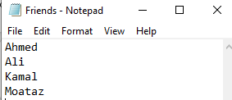
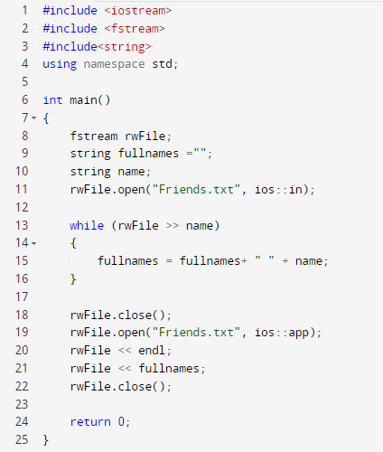
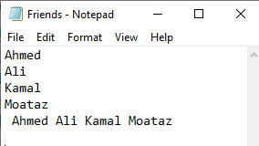
Reading and writing to the same file
Write a program that opens a file with existing names and reads its contents. The program should append the names again to the same file.

Slide 17
File Position Pointers
Both istream and ostream provide functions for repositioning the file-position pointer. These functions are seekg ("seek get") for istream and seekp ("seek put") for ostream.
The argument to seekg and seekp normally is an integer. A second argument can be specified to indicate the seek direction.
The seek direction can be:
ios::beg (the default) for positioning relative to the beginning of a stream.
ios::cur for positioning relative to the current position in a stream.
ios::end for positioning relative to the end of a stream.

Slide 18
File Position Pointers
ifstream fin;
fin.open(“sample.txt”);
fin.seekg( n ); // position to the nth byte of file (assumes ios::beg)
fin.seekg( n, ios::cur ); // position n bytes forward in file
fin.seekg( -n, ios::end ); // position n bytes back from end of file
where n is an integer number

Slide 19
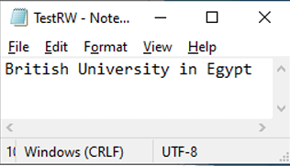

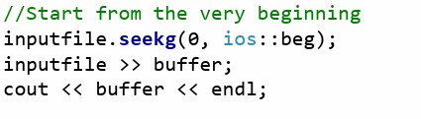
Example 1 on using seekg
Assume that I have a file called TestRW containing only the statement “British University in Egypt”
string buffer;
string filename =“TestRW.txt”;
fstream inputfile;
British

Slide 20
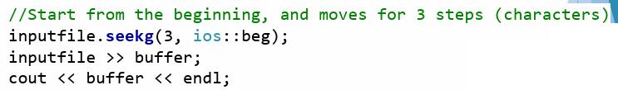
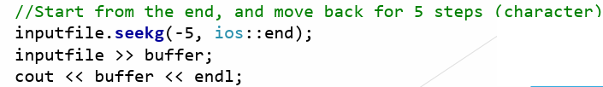
Example 1 on using seekg
Assume that I have a file called TestRW containing only the statement “British University in Egypt”
tish
Egypt

Slide 21
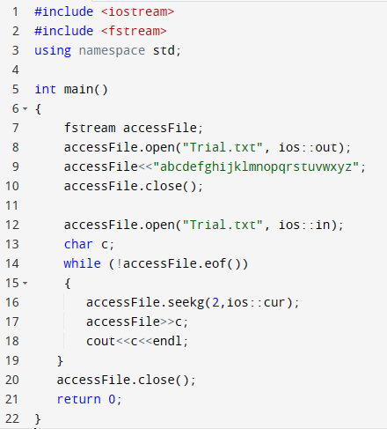
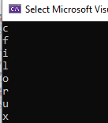
Example 2 on using seekg

Slide 22
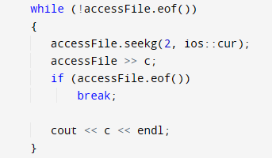

Example on using seekg
Notice that when the last read occurred after reaching character ‘y’. And when the reading pointer moves by two character by the “seekg()” function, the pointer reaches the end of the file and nothing to read. In this case, the last read fails to read any character, and so the value of c remains of the same value x.
We can modify this part as follows:

Slide 23

Thank You

